Slide 1
Earning and Sustaining Relevance as a Fiduciary Advisor
2022 Trust Advisor Forum

Slide 2
Headline
Success as an advisor comes from earning and sustaining relevance with clients

Slide 3
What is relevance with clients?
Pertinence, meaningfulness, importance a business earns
Finite shelf life, continually re-earned
Perpetual motion in business is norm; speed can vary
Must continually reinvent, evolve business practices

Slide 4
Today’s actions create tomorrow’s relevance

Slide 5
Q: Two years from now, wealth client expectations of financial services providers will be…
Much lower than today (advice, engagement, service level, technology, products)
Lower than today
About the same as today
Greater than today
Much greater than today

Slide 6
What’s an advisor to do?
Define your role
Master the art of inquiry
Anticipate what’s next
Act on reality
Practice agility

Slide 7
Define your role
Understand
Analyze
Advise
Evolve
Articulate

Slide 8
What we know about wealth clients
Growing cultural, generational, gender diversity
Expectations for advice, engagement, individualization
Expanding definition of value
Best access to services, products, wealthtech
Complex ecosystems
Aggressively pursued by service providers

Slide 9
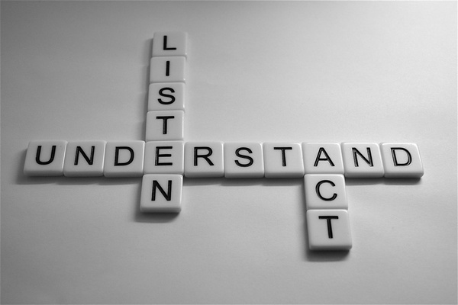
What clients expect from advisors
Know them
Understand them
Anticipate needs
Help them see beyond their line of sight
Deliver

Slide 10
Factors most meaningful in earning and sustaining relevance with clients…

Slide 11
Perspectives on Advisor Relevance
Topic/Issue
Clients’ View
Advisors’ View
Clients’ View
Advisors’ View
(agreement)
(agreement)
(agreement)
(agreement)
Open to discussing what clients value most in life
50%
87%
Open to discussing what clients value most in life
50%
87%
Provide recommendations based on client’s personal goals, needs,
49%
90%
Provide recommendations based on client’s personal goals, needs,
priorities
49%
90%
priorities
Communicates importance of considering all areas of life when
47%
81%
Communicates importance of considering all areas of life when
creating a plan
47%
81%
creating a plan
Contacts clients on a regular basis to see what changes in life may
39%
85%
Contacts clients on a regular basis to see what changes in life may
affect their financial plan
39%
85%
affect their financial plan
Source: Developing and Maintaining Client Trust and Commitment in a Rapidly Changing Environment, 2/8/22

Slide 12
Mastering the Art of Inquiry
Grounded in authentic curiosity
Curiosity leads to questions
Meaningful questions guide discovery, learning

Slide 13
Effectiveness in Learning About Clients
Topic/Issue
Clients’ View
Advisors’ View
Clients’ View
Advisors’ View
(agreement)
(agreement)
(agreement)
(agreement)
Open to discussing what clients value most in life
50%
87%
Cultural values
41%
68%
Provide recommendations based on client’s personal goals, needs,
49%
90%
Personality type, traits
38%
73%
priorities
Communicates importance of considering all areas of life when
47%
81%
Attitudes, beliefs about money
53%
80%
creating a plan
Contacts clients on a regular basis to see what changes in life may
39%
85%
Family history, values
53%
67%
affect their financial plan
Source: Developing and Maintaining Client Trust and Commitment in a Rapidly Changing Environment, 2/8/22

Slide 14
Inquiry approach
Comfort asking meaningful, relevant questions
Natural, conversational, empathic manner, even with difficult topics
Let responses guide subsequent questions

Slide 15
Understanding priorities
Save for retirement
Travel
Vacation home
Support family members
Philanthropic giving
Protect assets
Education
Wealth transition
Legacy
Next venture
Notes:
Use examples of a couple and of a multi-gen relationship

Slide 16
Knowing a client: Process vs. Event
Beyond due diligence, profile, IPS
Chapters in a story still being written
Dynamic, flowing changes in the client’s financial life
Move past legacy gaps
Advisor’s responsibility

Slide 17
Steps to mastering the Art of Inquiry
Recognize how curiosity creates a pathway
Build a repertoire of open-ended, purposeful questions
Frame questions around points of curiosity
Listen for invitations for follow-on questions
Develop confidence in diplomatically asking why questions

Slide 18
Q: Over the next 2 years, I expect to generate most of my new business from…
Direct outreach to qualified prospects
Centers of influence
Referrals from existing clients
Introductions from partners within my firm
Prospects contacting the firm seeking services

Slide 19
Anticipating what’s next
an·​tic·​i·​pate | \ an-ˈti-sə-ˌpāt
to give advance thought, discussion, or treatment to
to foresee and deal with in advance
to act before another so as to prepare

Slide 20
If this, then that…

Slide 21
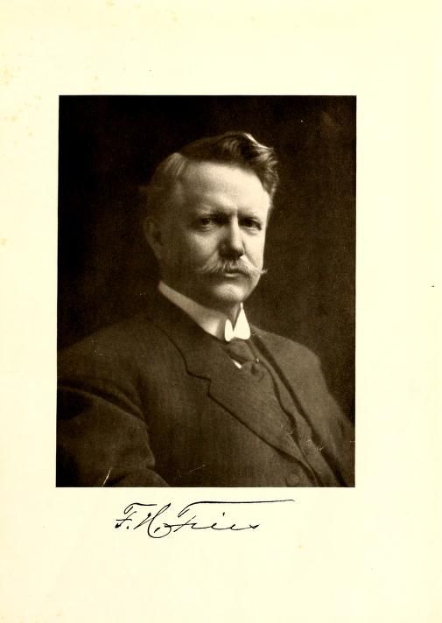
Roots in relevance…
…the trust company must handle money matters of the accounts it manages and anticipate financial needs of the estate for the future

Slide 22
We don’t know what we don’t know; neither do they
Financial lives in perpetual motion
Advisors bring economies of experience, knowledge
Anticipate needs
Your ordinary is their extraordinary
Unprecedented wealth transfer doesn’t mean surprises

Slide 23
Acting on reality
All relationships are dynamic
Life changes - financial life corollary
Unanticipated twists and turns trigger need for new advice
Understand, Analyze, Advise, Evolve
Earned relevance positions you as a first call

Slide 24
Successful advisors…
Identify life changes affecting their clients’ financial lives
Provide advice to navigate expected and unexpected changes
See fulfilling their role as a dynamic process

Slide 25
Q: What is the most important characteristic in selecting an advisor?
Location of the firm
Investment offering
Digital capabilities
Firm’s reputation
Advisor’s reputation
Notes:
Per Spectrem,
67% Millennials – Firm
60% X - Firm
57% Boomers – Firm
55% Silent Gen – Firm
33% Millennials – Advisor
40% X – Advisor
43% Boomers – Advisor
45% Silent Gen - Advisor

Slide 26
Practicing agility
All is flux - Heraclitus
Normal is not a destination; it is in continual redefinition
What is the next version of your practice model?

Slide 27
Adaptive Disruption

Slide 28
Focus on advisor agility
Operating models have a shelf-life
Who, how, when, where will look different
When we don’t ride elevators, the pitch may not fit
Meeting expectations doesn’t differentiate
Pre-emptive adjustment meets stable and trusted

Slide 29
Differentiating yourself as an advisor
Why you?
Why your firm?
How will you earn, sustain relevance?

Slide 30
Q: Over the next 2 years, greatest threat to relationship retention is…
Clients passing away
Intensity of competitors
New, nontraditional competitors
Terms of a trust
Fees

Slide 31
To sustain relevance with clients, over the next 2 years, your business operating model will:

Slide 32
Questions of relevance
How does your firm define relevance with clients?
How are clients’ financial lives different today than 2 years ago or 2 years out?
What do we need to do to earn relevance in our clients’ financial lives tomorrow?

Slide 33
Overlooking Relevance?
This Photo by Unknown Author is licensed under CC BY

Slide 34
Today’s actions for tomorrow’s relevance…
Define your role
Master the art of inquiry
Anticipate what’s next
Act on reality
Practice agility

Slide 35
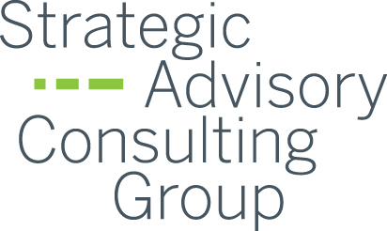
Thank You
Dave Coffaro
www.davecoffaro.com
www.sacgusa.com

